Slide 1
Pretense Listening This involves more hearing than listening. It means pretending through facial expressions that one is listening to the communicated message when actually one is not.

Slide 2
Selective Listening Listening is done only partly or selectively. It involves selecting the desired part of the message and ignoring the undesired part of the message.

Slide 3
Discriminative Listening -whereby the difference between different sounds is identified. If you cannot hear difference then you cannot make sense of the meaning that is expressed.

Slide 4
Barriers of Listening

Slide 5
Low Concentration - not taking time to minimize external distractions - pretending to pay attention when you are really thinking about something completely different or daydreaming.

Slide 6
Jumping to conclusions. - responding in a manner that is not expected, out of place, or inappropriate Interrupting - interrupting someone who is speaking in order to speak

Slide 7
Lack of Prioritization - multitasking, or being engaged in other activity, as you are listening to someone else - being unable to offer feedback or a response when asked to do so;

Slide 8
Evaluating and judging - not paying attention to those unspoken things that are a part of body language; -Focusing on Style, Not Substance Selective listening - tuning out what you hear because you find it uninteresting

Slide 9
Attributes demonstrates that you are listening

Slide 10
Concentration Eye Contact Body Language Avoid Interruption Ask Question

Slide 11
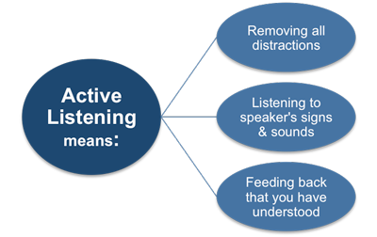

Slide 12
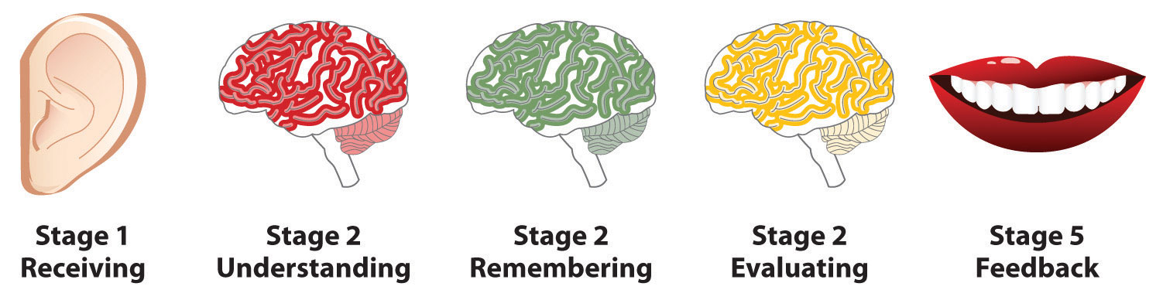
Stages of Listening

Slide 13
Receiving The first stage of the listening process is the receiving stage, which involves hearing and attending.

Slide 14
Understanding This is the stage during which the listener determines the context and meanings of the words he or she hears.

Slide 15
Evaluating -it allows the listener to form an opinion of what they heard and, if necessary, to begin developing a response.

Slide 16
Responding -the listener provides verbal and/or nonverbal reactions based on short- or long-term memory.

Slide 17
Remembering what you hear is key to effective listening.

